Slide 1
ON LINE EXAM
Prepared By :-
Patel Shruti I.
Patel Kinjal A.
Patel Hiral R.
Patel Naiya N.
Guide By :-
Amit Gorvadiya.

Slide 2
What is .NET ?
.net as a framework
There are two types of .NET
ASP.NET( Web Application)
VB.NET(Window Application)
ASP:- Active Server Pages

Slide 3
Asp.Net (Web Application)
Creating Dynamic web pages
Visual Studio 2005
Version Framework
2003
2005
2008
1.0 / 1.1
2.0
3.0 / 3.5

Slide 4
Asp.Net (Web Application)
2005 ----- 2.0
Language -- 44
(html, Dhtml, c++, php, c#, J#, vb, java script, vbscript…. )
Class -- 12,990
(system. Data. oldb….)

Slide 5
OVER VIEW OF SYSTEM:-
The Project named as “ONLINE EXAM” is the WEB APPLICATION.
Online exam is not university exam but it is G.K exam.
Any Person can be Give G.K exam.
Our G.K exam Provide the Rules & Regulation and Guideline.

Slide 6
SYSTEM DEFINATION
PURPOSE:
Online Exam is more compactable then another examination. It require less staff saving the time of student. Quickly check the answers and declare the result at a time.
SYSTEM :
This system is developed for betterment of students as well as distance learning student.

Slide 7
Admin:-
Admin can be do insert ,update, delete Answer & question.
The Admin can creating Rules & Regulation for G.K exam.
The Admin can creating Question for G.K exam.
The Admin can create guideline.
Admin create Books & website.

Slide 8
User:-
The User can view my website.
The User can fill up registration form for the exam.
The User can login in my website.
The User view question for exam.
The User view guideline.
The User can View book .
The User view result.

Slide 9
Uml Diagram:-
Unified Modeling Language
Use case Diagram.
Activity Diagram.
Class Diagram.

Slide 10
UML DIAGRAM

Slide 11
<1>Use Case Diagram

Slide 12
ONLINE EXAM
Login
Ragistration
Manage Que.
View Que.
Manage R & R
View R & R
Manage Book
Admin
View Book
User
Manage Guideline
View Guideline
View Result

Slide 13
MANAGE QUESTION
Create Question
Update Question
Delete Question
Admin

Slide 14
MANAGE R & R
Insert R&R
Update R&R
Delete R&R
Admin

Slide 15
MANAGE BOOK
Insert Book
Update Book
Admin

Slide 16
MANAGE GUIDELINE
Insert Guideline
Update Guideline
Delete Guideline
Admin

Slide 17
Symbol of Activity:-
Starting point.
Activity.
Condition.
Concurrent.
End Point

Slide 18
<2> Activity Diagram

Slide 20
<3> Class Diagram

Slide 21
Registration
Question
Add();
Add();
Update();
Update();
Delete();
Delete();
View();
Book
Result
Insert();
Generate();
Update();
Display();
Delete();
View();

Slide 22
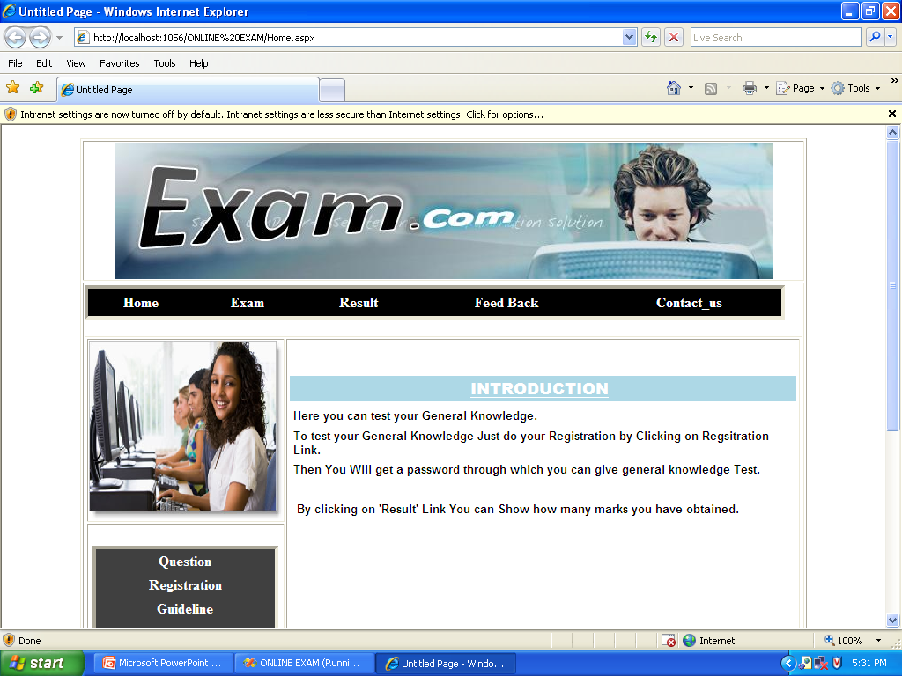

Slide 23
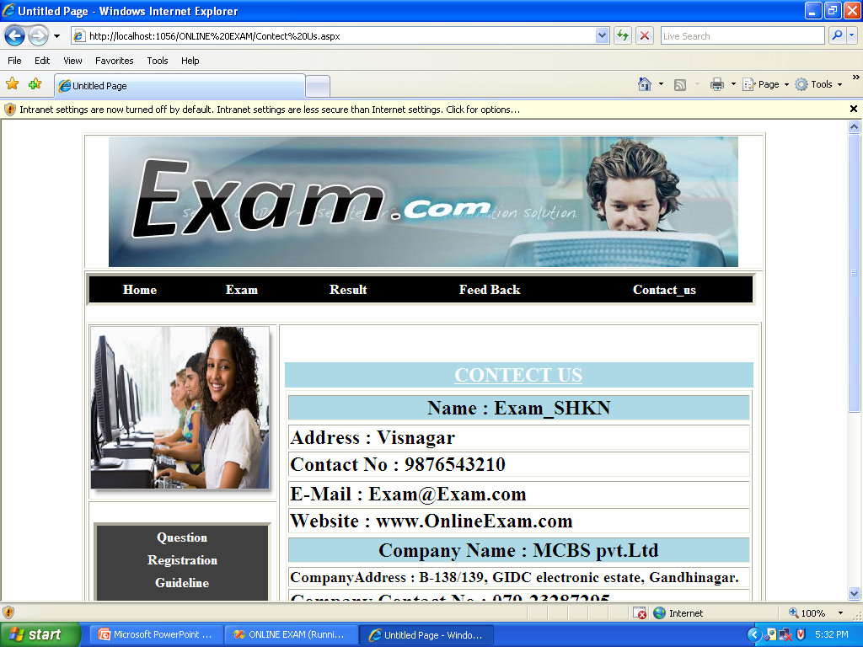

Slide 24
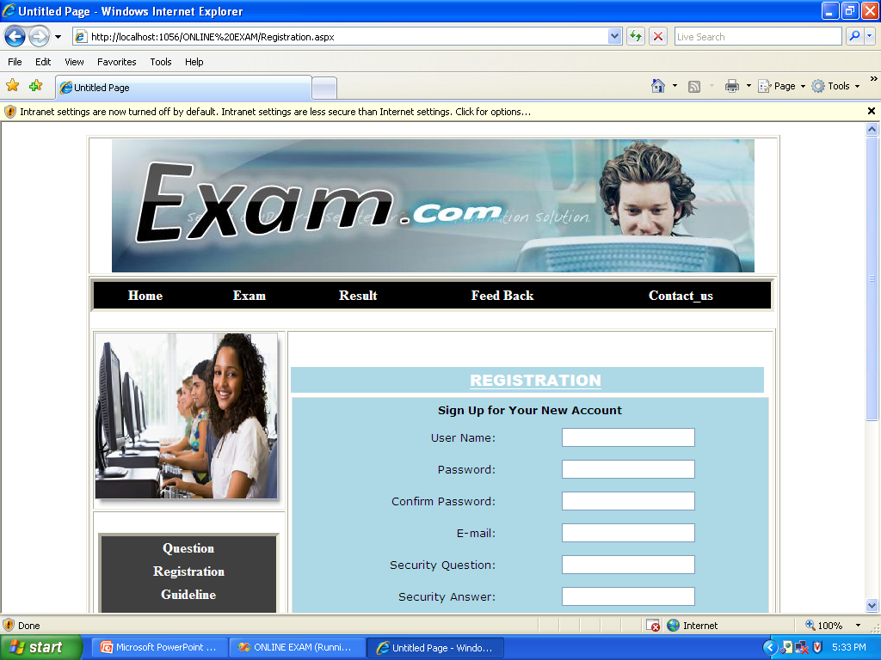

Slide 25
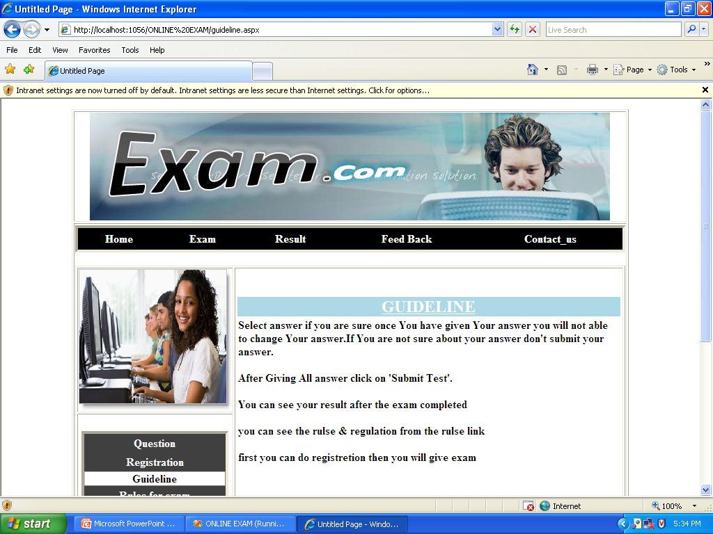

Slide 26
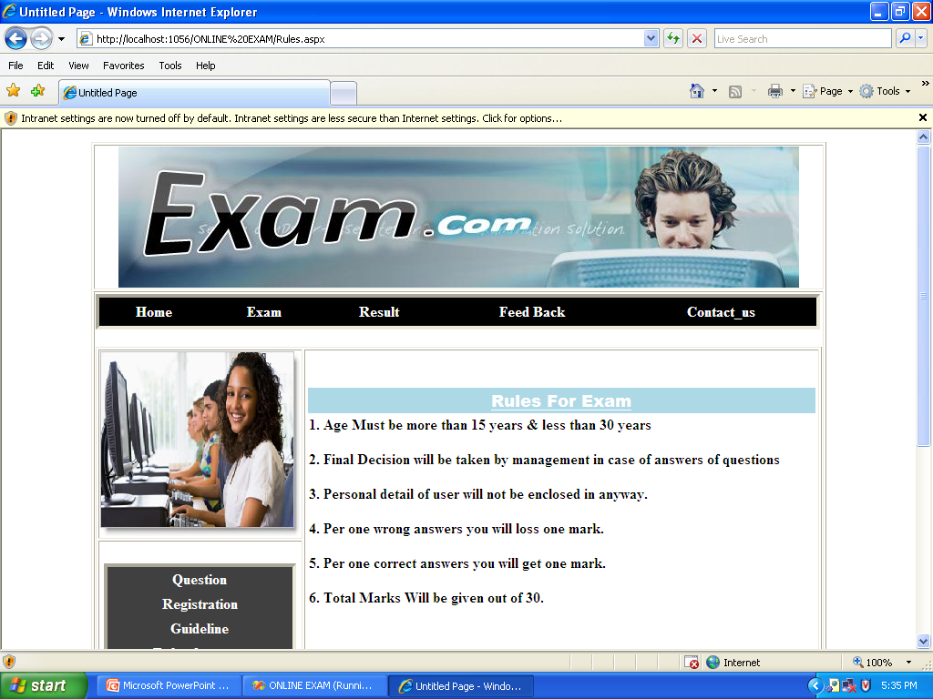

Slide 27
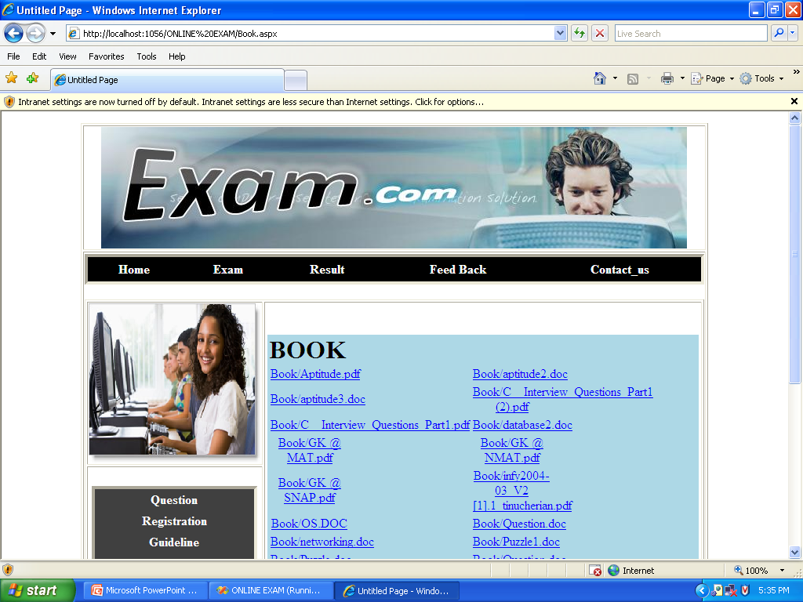

Slide 28
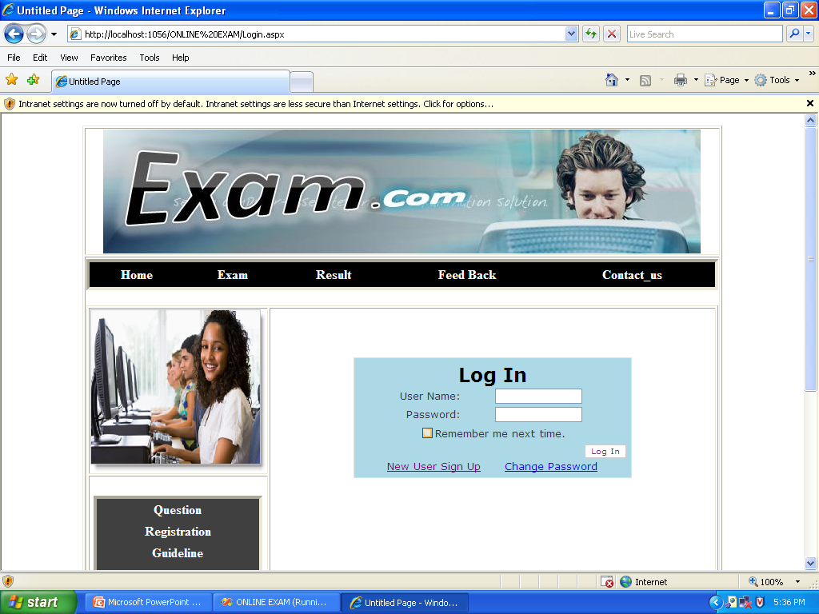

Slide 29
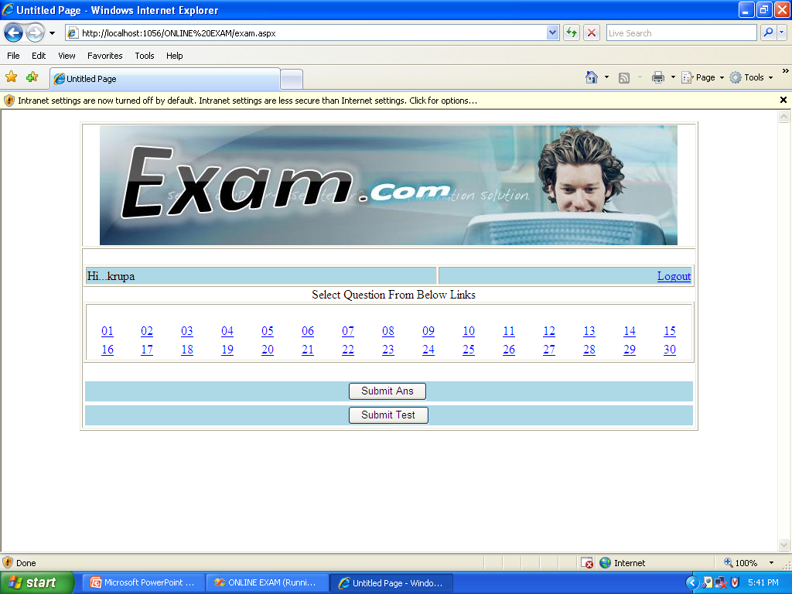

Slide 30
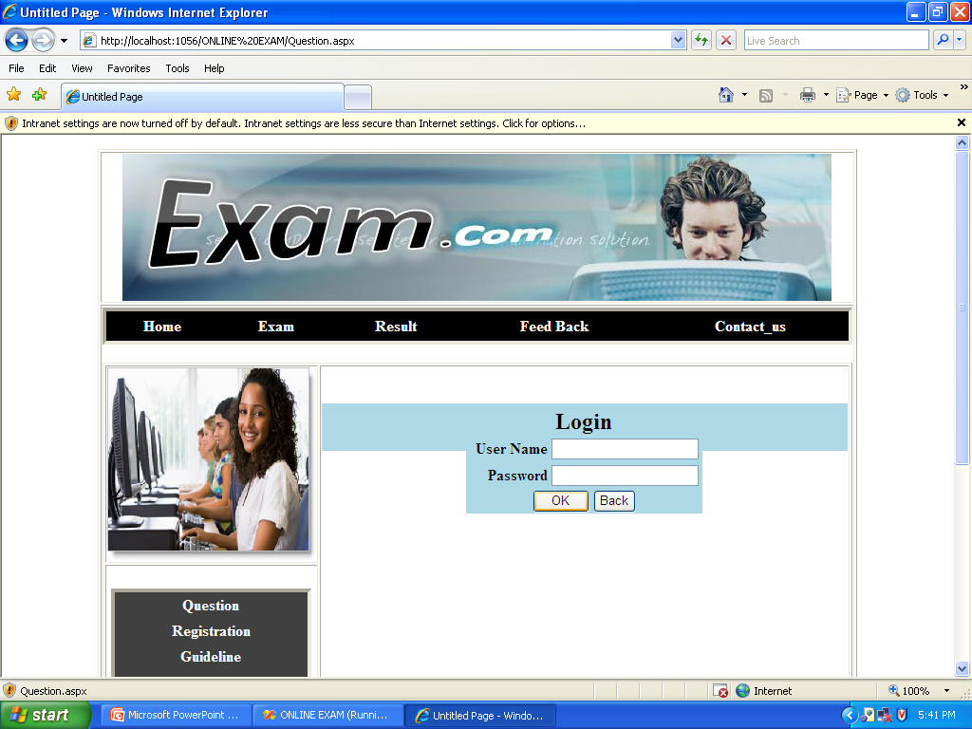

Slide 31
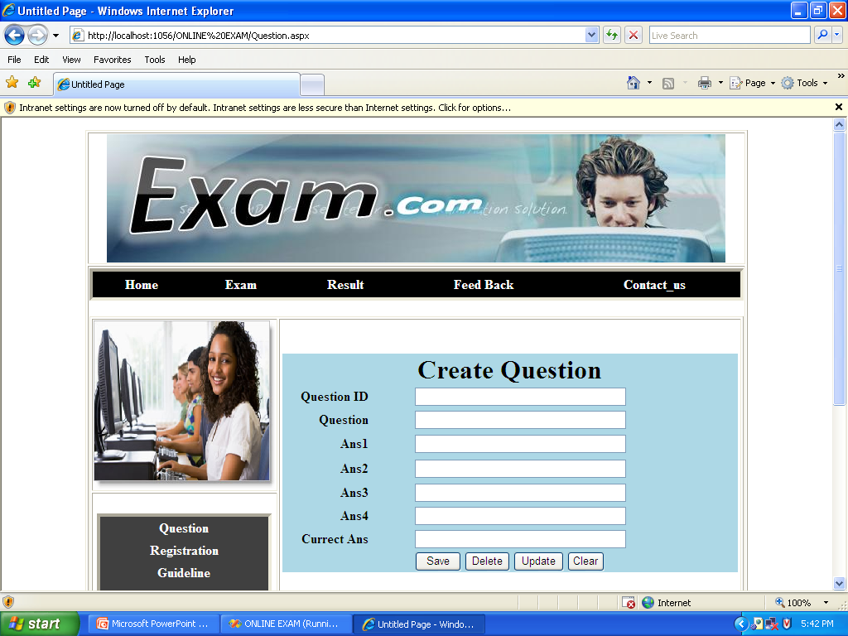

Slide 32
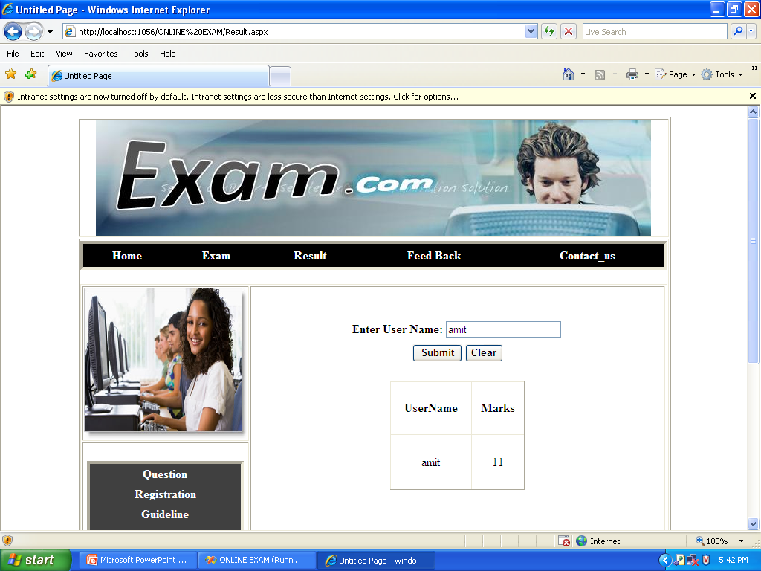

Slide 33
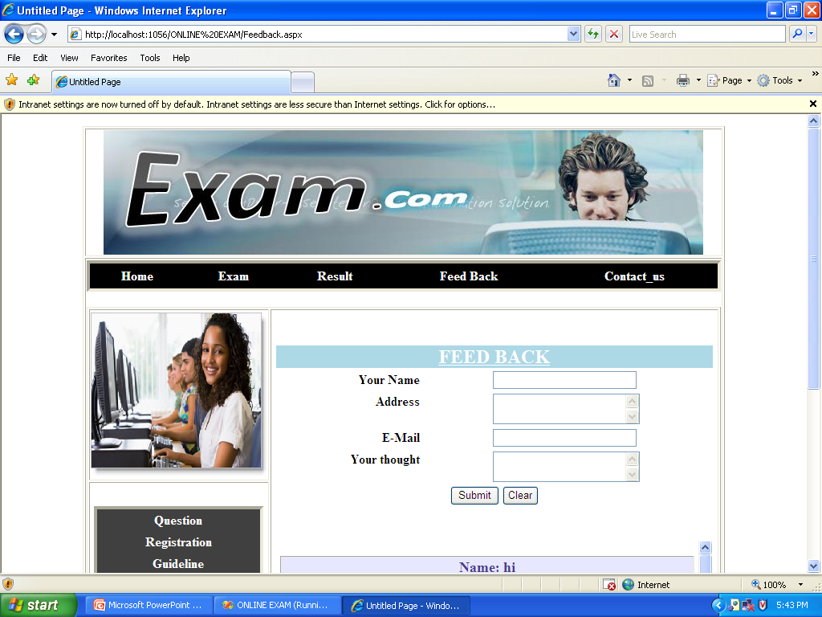

Slide 34
Thank You

